Slide 1
Computer Hardware – System Unit

Slide 2
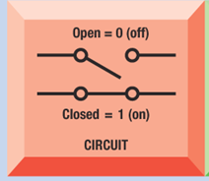
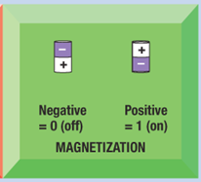
Digital Data Representation
The basic building block of the CPU is the transistor. A CPU can contain billions of them
The 0s and 1s used to represent data can be represented in a variety of ways.
Transistor circuits can be open (0) or closed (1)
Transistors can have an electrical state of negative (0) or positive (1)

Slide 3
Digital Data Representation
A numbering system that uses only 0’s and 1’s is the Binary numbering system.
Each transistor represents one Bit.
A bit by itself is not sufficient to represent information.
The basic unit for representing information in a computing system is the Byte.
A Byte is made up of 8 Bits.

Slide 4



Digital Data Representation
Examples of Byte Data representation
8-bit byte for the number 3
8-bit byte for the number 5
8-bit byte for the capital letter T
A File is a named collection of bytes that represents any type of data

Slide 5

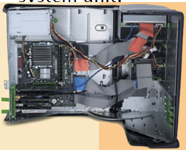
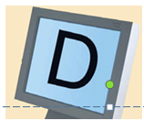
Digital Data Representation
Converting to and from Binary.
The user presses the capital letter D (shift+D key) on the keyboard.
An electronic signal for the capital letter D is sent to the system unit.
The signal for the capital letter D is converted to its Unicode binary code (01000100) and is stored in memory for processing.
After processing, the binary code for the capital letter D is converted to an image, and displayed on the output device.

Slide 6
How Components Interact In a PC
CPU
Control Unit
Arithmetic Logic Unit
Instructions
Data
Information
Input
Devices
Output
Devices
Data
Memory
Information
Instructions
Data
Information
Storage Devices

Slide 7
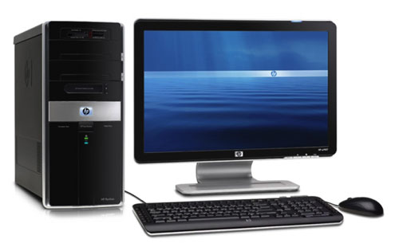
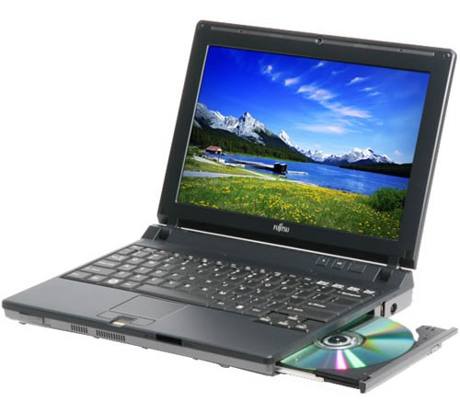
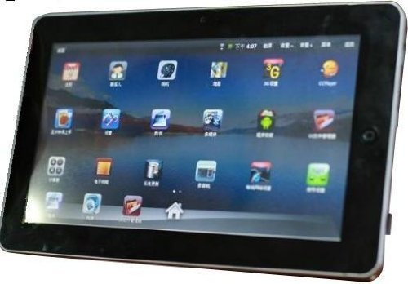
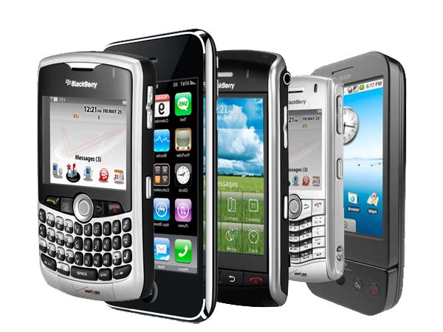
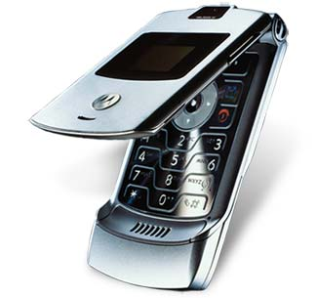
The System Unit
The case that contains electronic components used to process Bytes

Slide 8
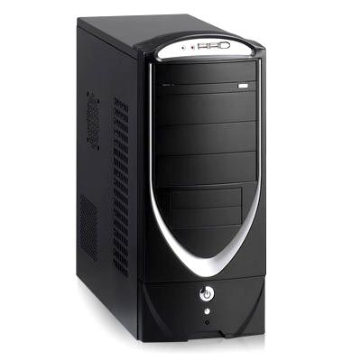
The System Unit
Common components of the system unit
  Mother Board
  Ports
  Drive Bays
  Power Switch
  Power Supply

Slide 9
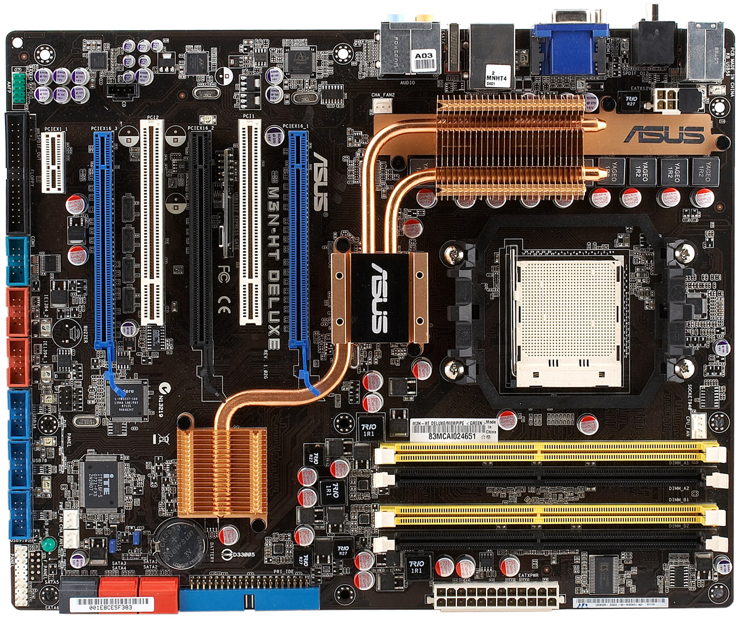
The Motherboard

Slide 10
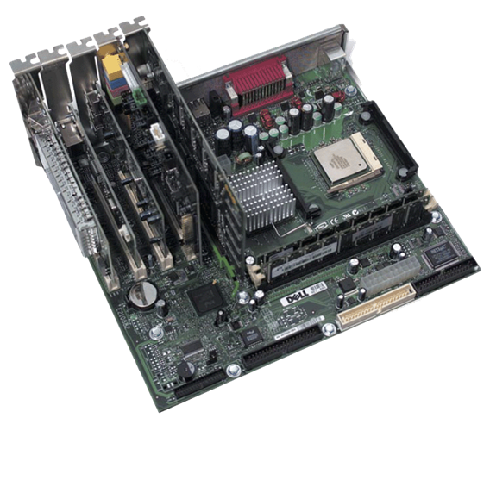
The Motherboard
Main circuit board in the system unit which contains;
  CPU
  Other IC’s
  Expansion slots
  Expansion cards
  Memory slots
  Memory cards
  Ports

Slide 11
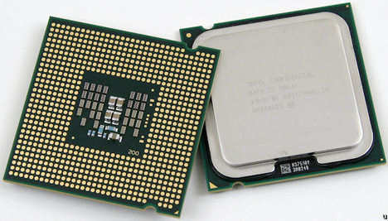
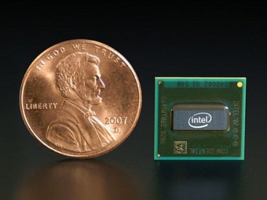
The CPU
The central processing unit (CPU or processor) is a computer chip that
  Performs the calculations and comparisons needed for processing
  controls the computer’s operations
Many CPUs today are multi-core CPUs that contain the processing components or cores of multiple independent processors in a single CPU

Slide 12
The System Clock and Machine Cycle
In order to synchronize all of a computer’s operations, a system clock—a small quartz crystal located on the motherboard—is used.
Whenever the CPU processes a single piece of microcode, it is referred to as a machine cycle

Slide 13
The System Clock and Machine Cycle
Sep 1 Fetch
The next instruction
Is fetched from cache or Ram
Sep 4 Store
The data or results are stored in registers or Ram
Sep 2 Decode
The instructions are decoded into a form the ALU or FPU can understand
Sep 3 Execute
The instructions are carried out

Slide 14
Memory
Memory is chips located inside the system unit that the computer uses to store data and instructions while it is working with them.
Two types of Memory
  volatile memory - loses its contents when computer's power is turned off
  nonvolatile memory - does NOT lose its contents when computer’s power is turned off.

Slide 15
Memory
RAM (random access memory) is used to store
  the essential parts of the operating system while the computer is running
  the programs and data that the computer is currently using.

Slide 16
Memory
A register is high-speed memory built into the CPU that temporarily stores data during processing
ROM (read-only memory) consists of nonvolatile chips that permanently store data or programs.

Slide 17
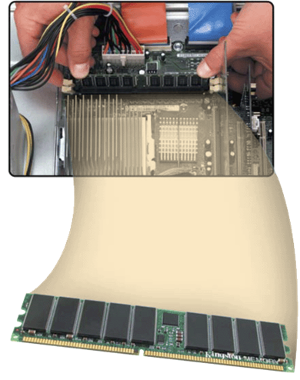
Memory Modules
RAM memory is found on memory modules.
Memory slots on motherboard hold memory modules
Memory modules come is specific sizes and speeds.

Slide 18
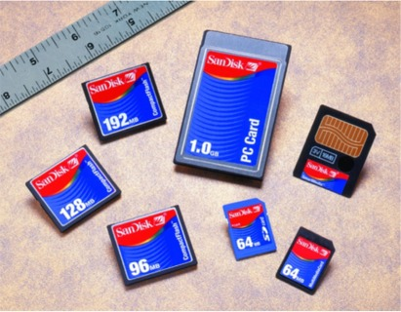
Flash Memory Cards
Nonvolatile memory that can be erased electronically and reloaded
Used with PDAs, digital cameras, digital cellular phones, music players, digital voice recorders, printers, Internet receivers, and pagers
Allows users to transfer data from mobile devices to desktop computers
Hot plugging allows you to insert and remove cards while computer is running under Widows XP operating system

Slide 19
Expansion Slots, Expansion Cards, and ExpressCard Modules
An expansion slot is a socket on the motherboard where a expansion card are inserted.
Expansion cards are used to improve the quality of the existing components on the mother board including
Plug and Play - the computer automatically configures cards and other devices as you install them

Slide 20
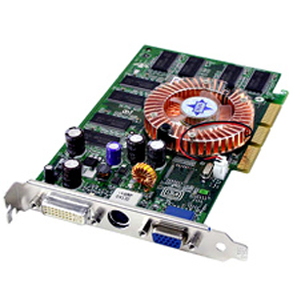
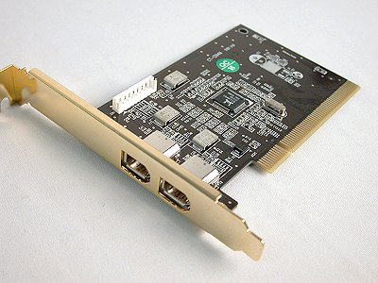
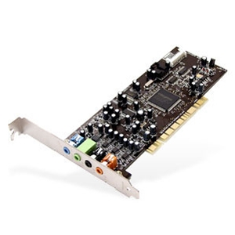
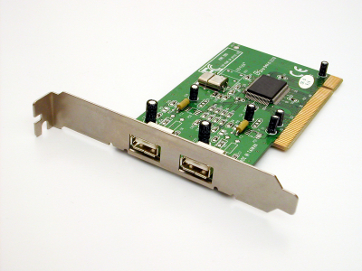
Expansion Slots, Expansion Cards, and ExpressCard Modules
Examples Include
  Video cards
  Audio cards
  USB port cards
  Firewire port cards

Slide 21
Expansion Slots, Expansion Cards, and ExpressCard Modules
Today most notebook and netbook computers use the newer ExpressCard modules.

Slide 22
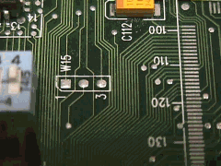
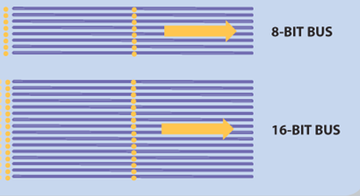
Buses
A bus is an electronic path over which data can travel.

Slide 23
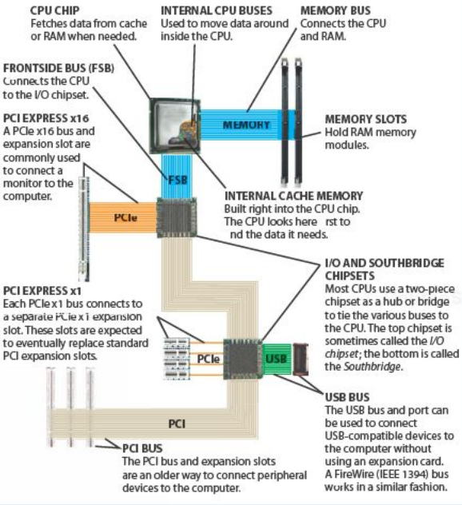
Buses

Slide 24
Ports and Connectors
Ports are the connectors located on the exterior of the system unit that are used to connect external hardware devices.
Each port is attached to the appropriate bus on the mother board so that when a device is
plugged into a port, the device can communicate with the CPU and other computer components.

Slide 25
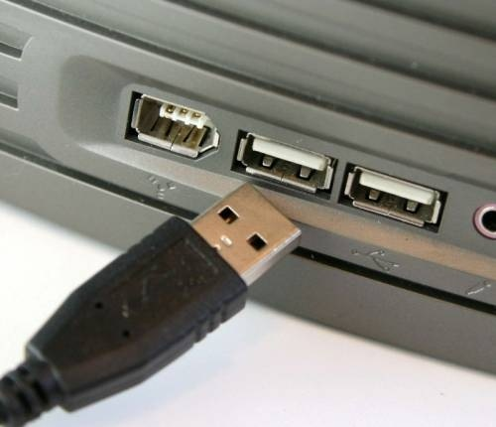
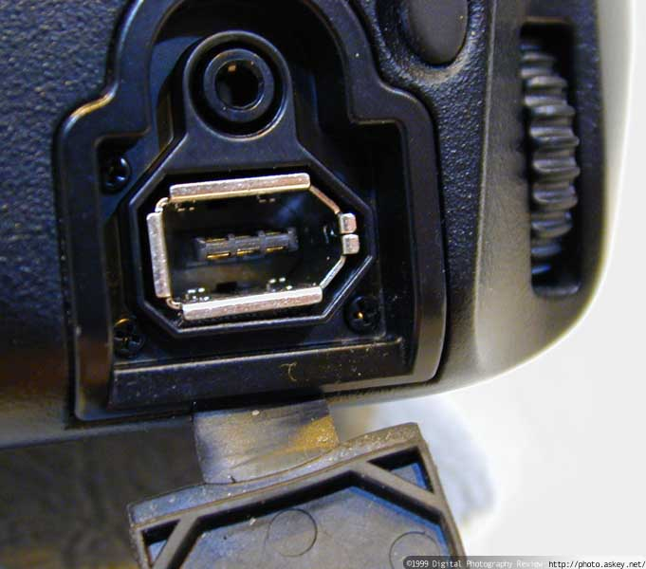
Ports and Connectors
USB
USB (universal serial bus) port can connect up to 127 different peripherals together with a single connector type
  PCs typically have four to eight USB ports on front or back of the system unit
Firewire
  Used to transfer video to computers

Slide 26
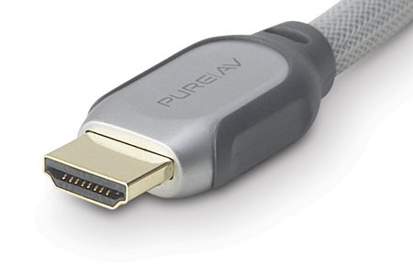
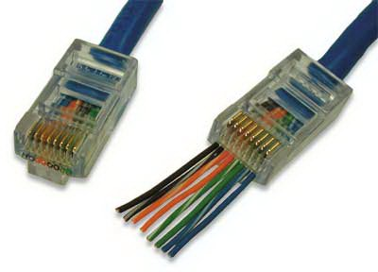
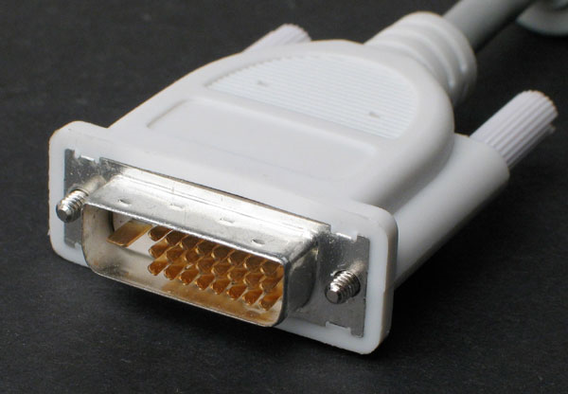
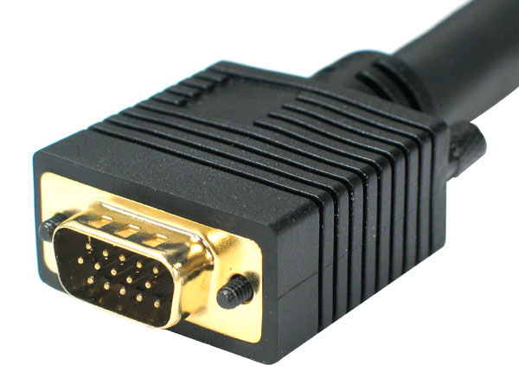
Ports and Connectors
15 Pin Video
Digital Video Interface
RJ 45
HDMI

Slide 27
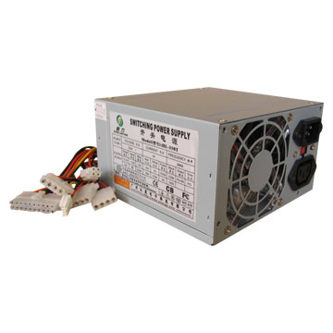
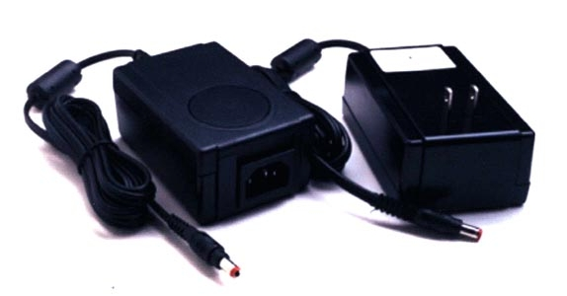
The Power Supply
Converts AC Power into DC Power
Fan keeps system unit components cool
External peripherals might use an AC adapter, which is an external power supply

Slide 28
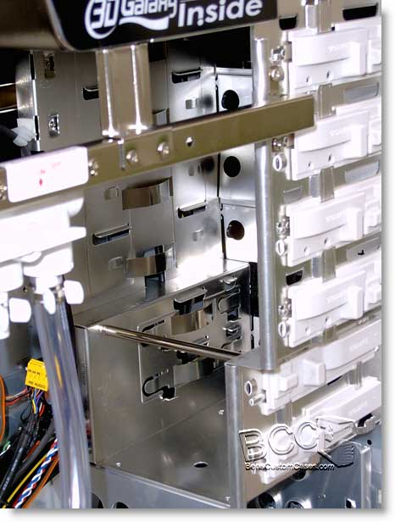
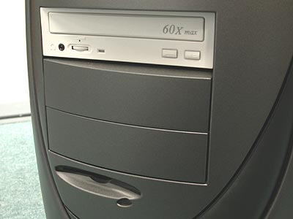
Bays
Area inside system unit used to install additional equipment
Two Types
  External
  Internal

Slide 29
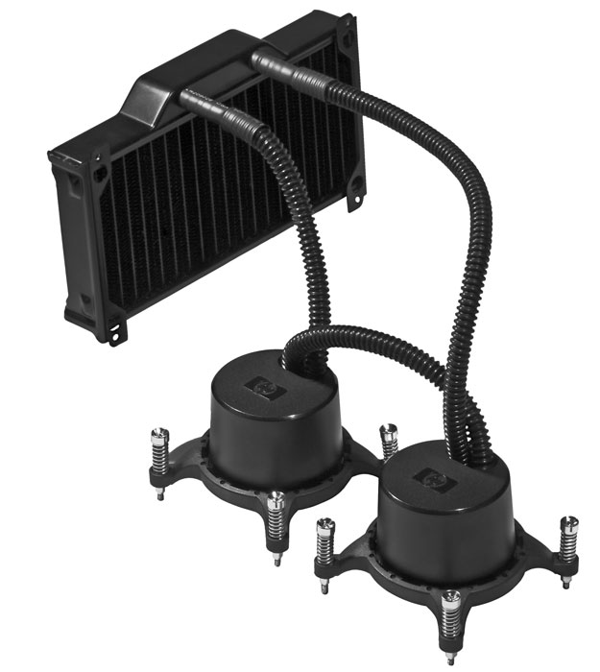
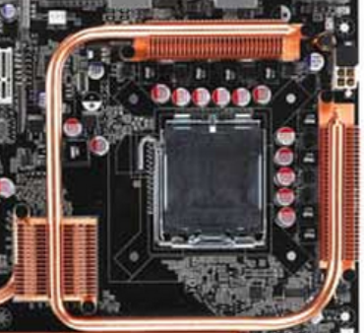
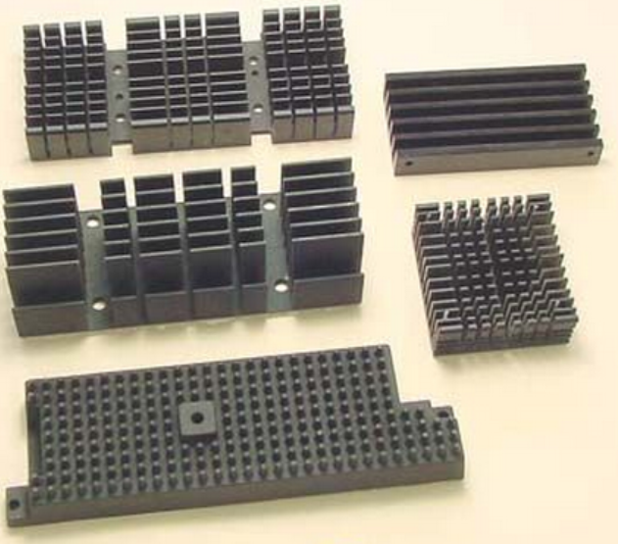
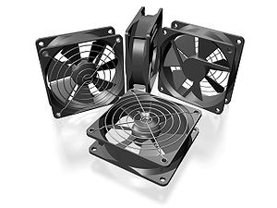
Cooling Systems
Cooling system include
  Fans
  Heat Sinks
  Heat pipes
  Liquid cooling systems

Slide 30
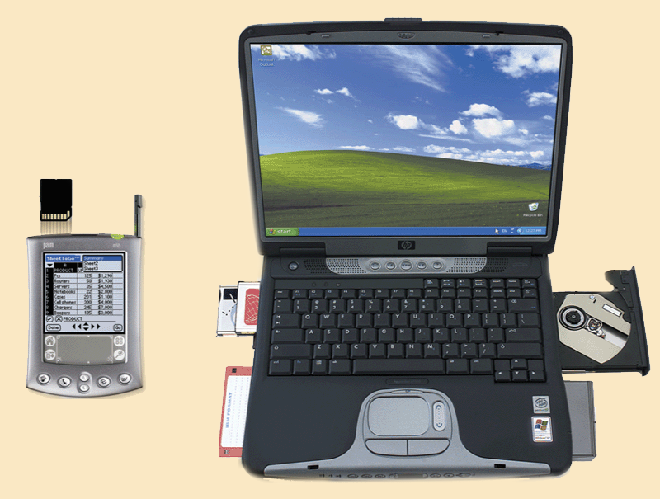
Mobile Computing Devices
Include notebook, weighing between 2.5 and 8 pounds,
or mobile device such as a PDA

Slide 31
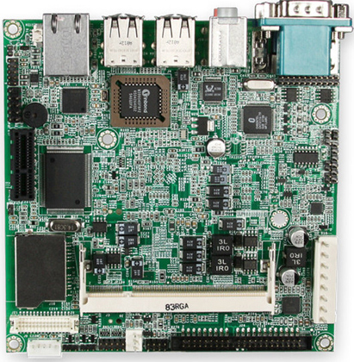
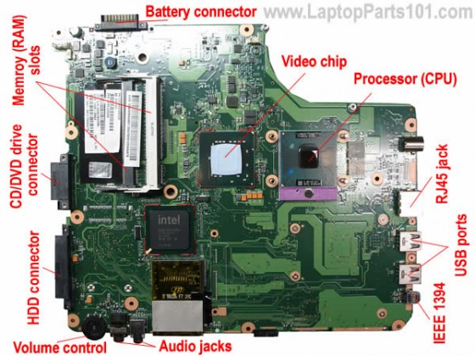
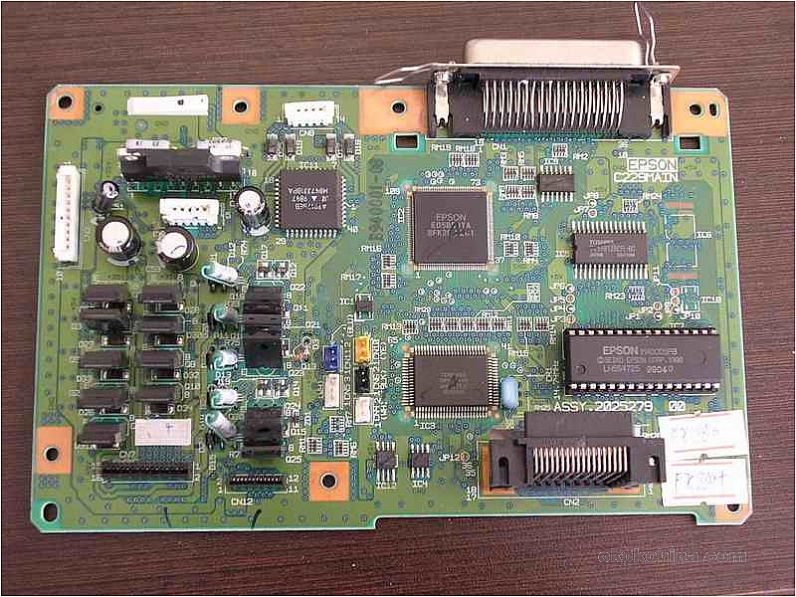
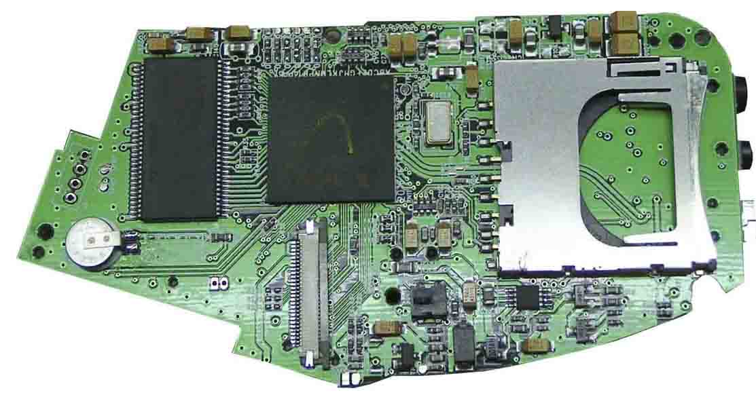
Mobile Computing Devices
Lab top motherboard
Webbook motherboard
PDA motherboard
Printer motherboard

